Slide 1
Basic of Python
Associate Prof. Huỳnh Trung Hiếu

Slide 2
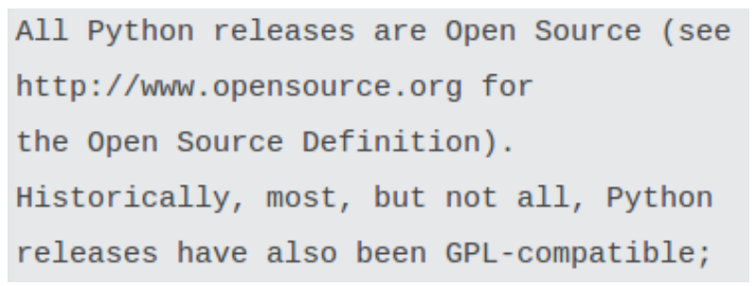
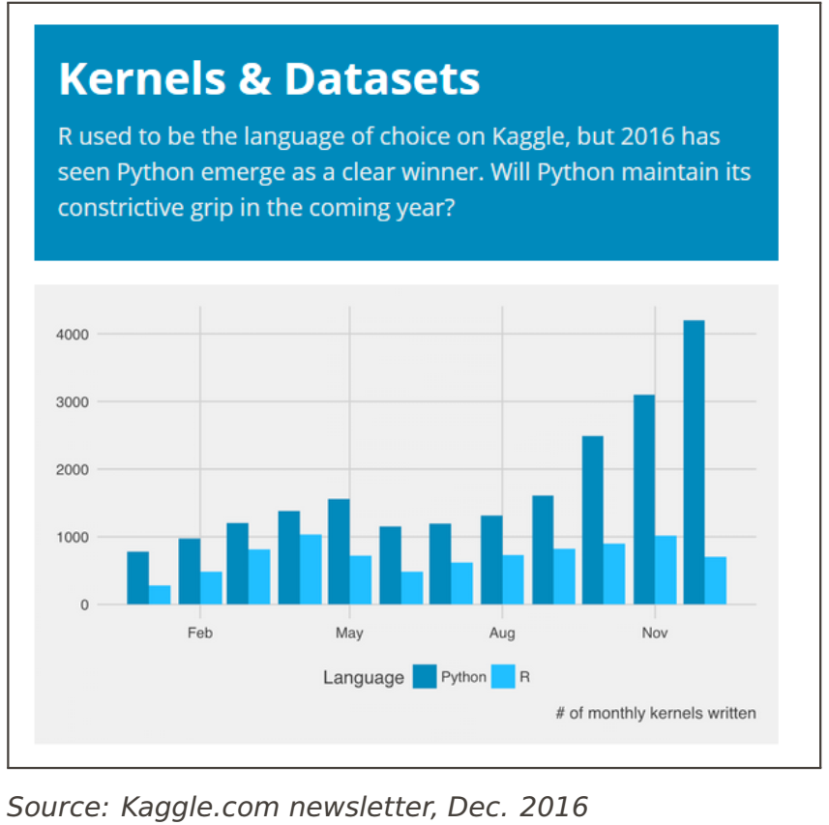
Why Python?
Python: Rapidly becoming the default platform for practical machine learning/data science.
This was not always the case: 10 years ago everyone was using Matlab.
However, due to licensing issues and heavy development of Python, scientific Python started to gain its user base.
Python’s strength is in its variability and huge community

Slide 3
Essential Modules
numpy: The matrix / numerical analysis layer at the bottom
scipy: Scientific computing utilities (linalg, FFT, signal/image processing...)
scikit-learn: Machine learning
matplotlib: Plotting and visualization
opencv: Computer vision
pandas: Data analysis
statsmodels: Statistics in Python
Tensorflow, keras: Deep learning
PyCharm: Editor
spyder: Scientific PYthon Development EnviRonment (another editor)

Slide 4
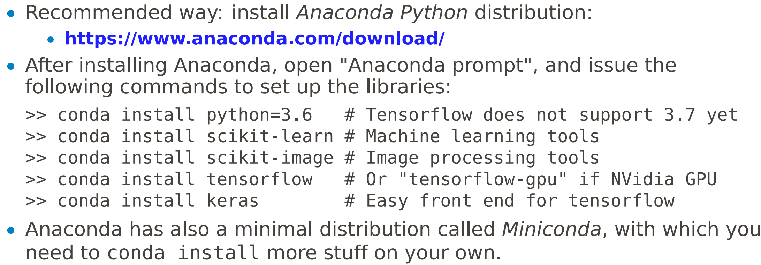
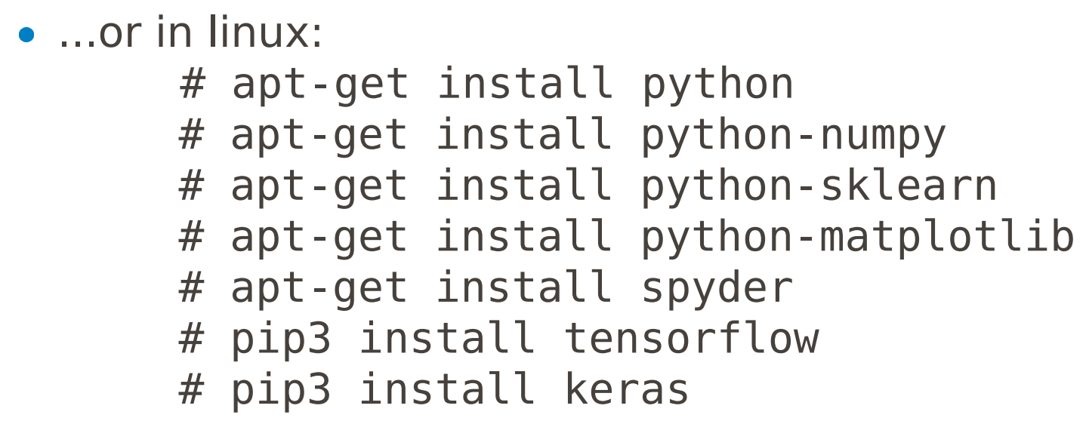
Where to get Python?

Slide 5
Language
Python was designed to be a highly readable language.
Python uses whitespace to delimit program blocks.
All used modules are imported using an import declaration. The members of a module are referred using the dot: np.cos([1,2,3])
Interpreted language. Also interactive with IPython extensions.

Slide 6
Editors
We can use the Spyder editor, Visual Studio Code, PyCharm.
The window contains panes: editor and console.
F5 : Run code; F9 : Run selected region.
Alternatively, you can use whatever editor you like, and run everything on the
Python code can be executed either from a script file (*.py) or in the interactive mode (just like Matlab).
For the interactive mode; just execute python from the command line.

Slide 7
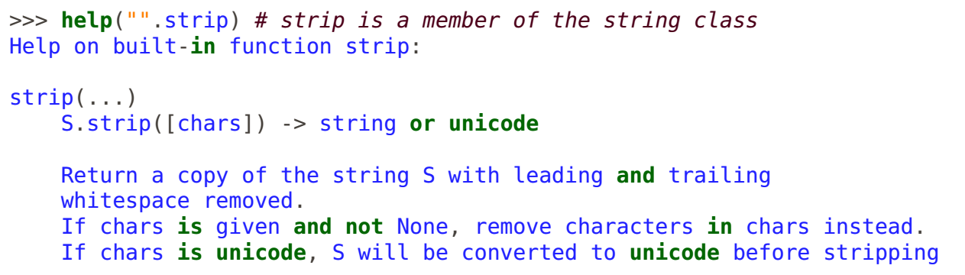
Help
For each command, help is there to refresh your memory

Slide 8
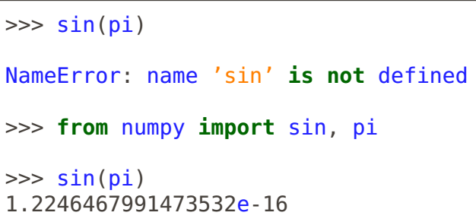
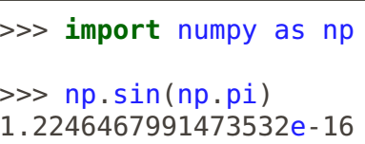
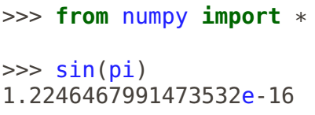
Using Modules
Python libraries are called modules.
Each module needs to be imported before use.
Three common alternatives:
Import the full module:
import numpy
Import selected functions from the module:
from numpy import array, sin, cos
Import all functions from the module:
from numpy import *

Slide 9
Using Modules
All methods support shortcuts; e.g., import numpy as np
Sometimes import <module> fails, if the module is in fact a collection of modules.
For example, import scipy. Instead, use import scipy.signal
Importing all functions from the module is not recommended, because different modules may contain functions with the same name.

Slide 10
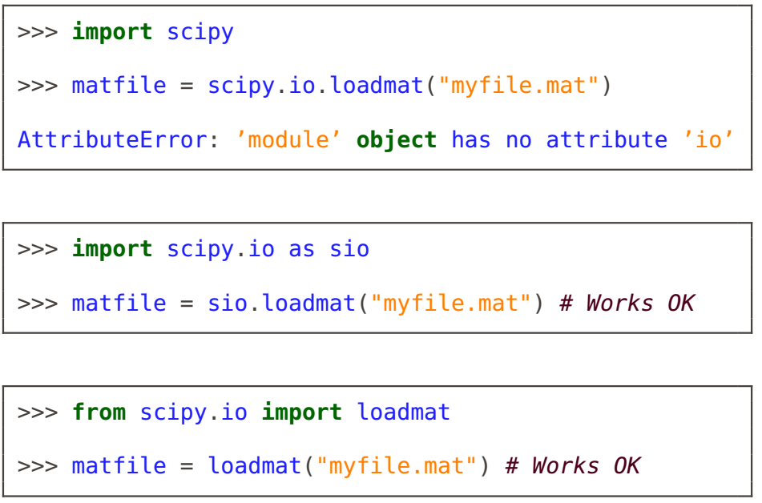
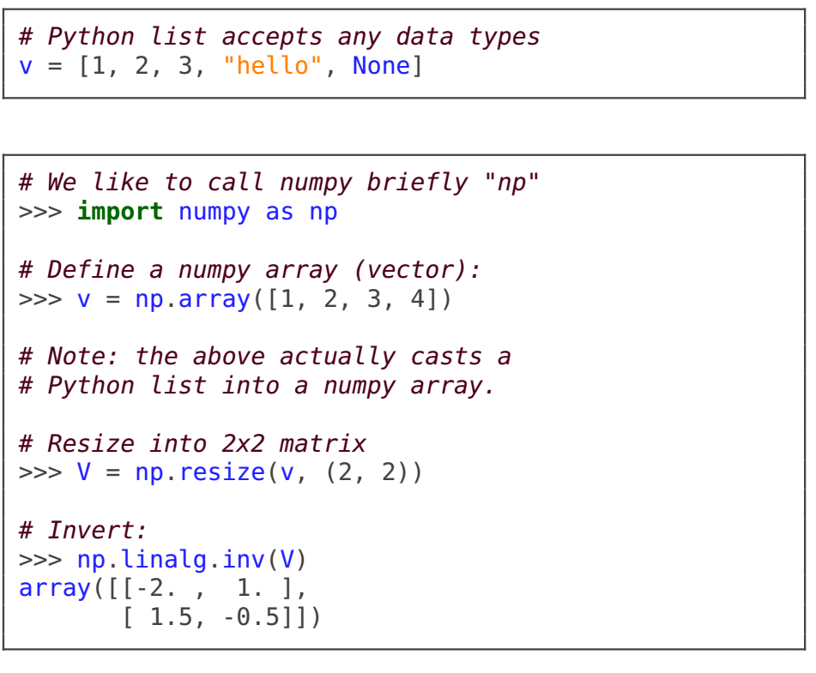
Using Modules
Practically all scientific computing in Python is based on numpy and scipy modules.
NumPy provides a numerical array as an alternative to Python list.
The list type is very generic and accepts any mixture of data types.
Although practical for generic manipulation, it is becomes inefficient in computing.
Instead, the NumPy array is more limited and more focused on numerical computing.

Slide 11
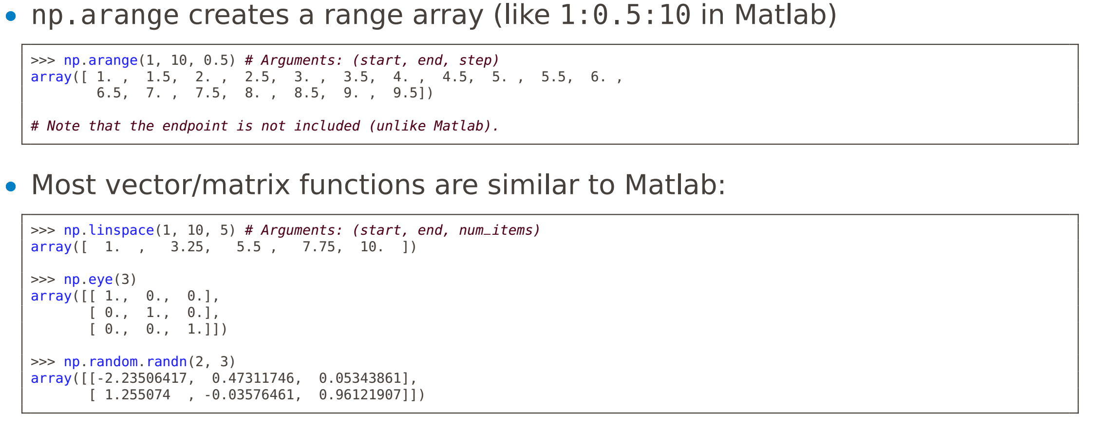
More on Vectors

Slide 12
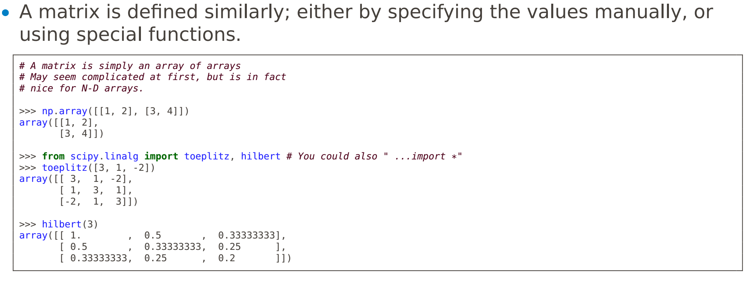
Matrices

Slide 13
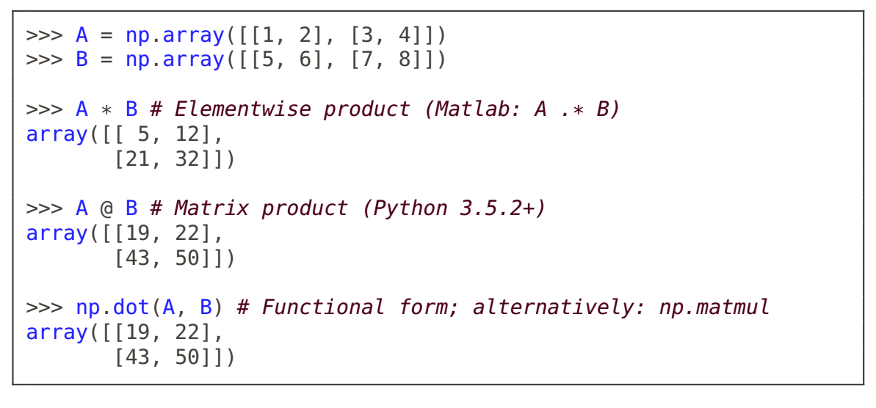
Matrix Product

Slide 14
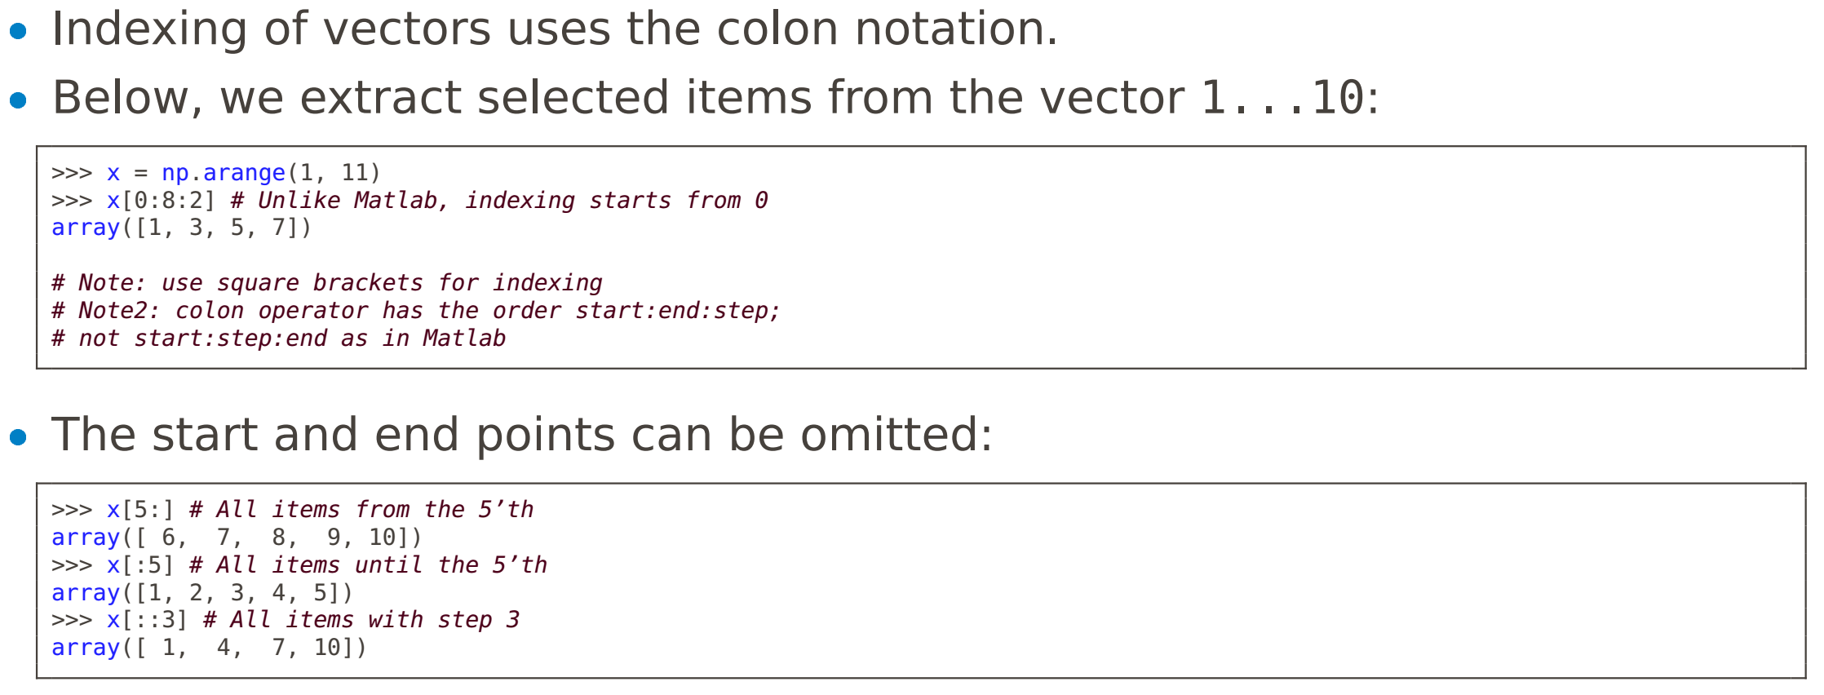
Indexing

Slide 15
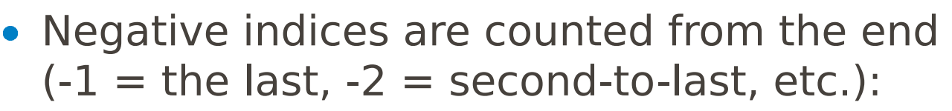
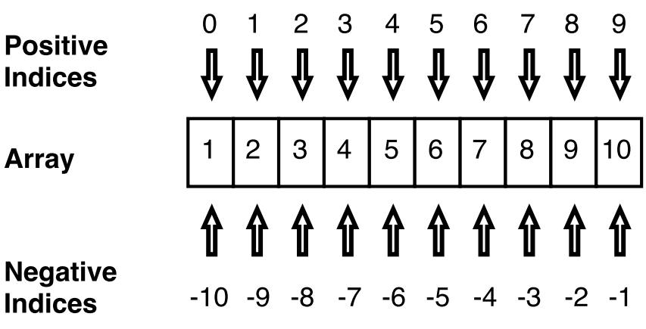
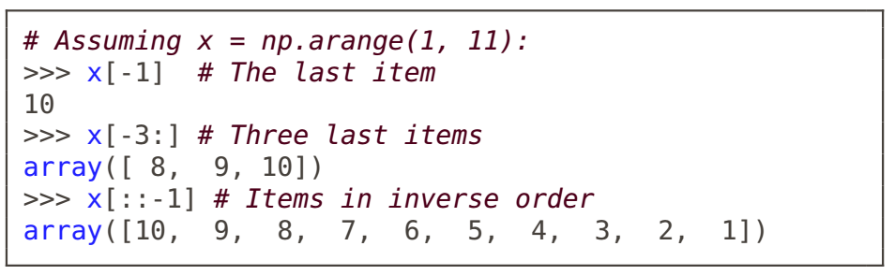
Indexing

Slide 16
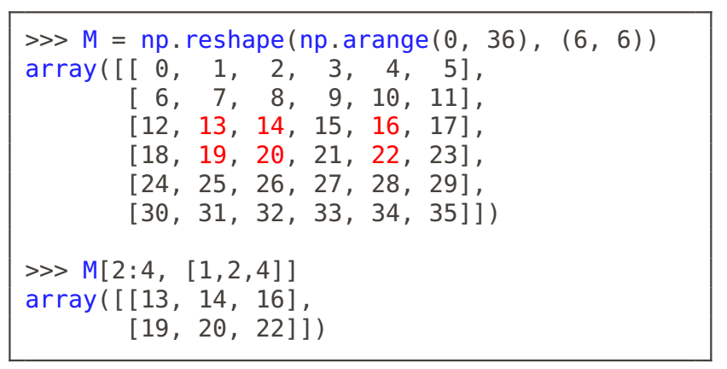
Indexing
Also N-dimensional arrays (e.g., matrices) can be indexed similarly. This operation is called slicing, and the result is a slice of the matrix.
In the example on the below, we extract items on the rows 2:4 = [2,3] and columns 1,2,4 (shown in red).
Note: the first index is the row; not "x-coordinate".

Slide 17
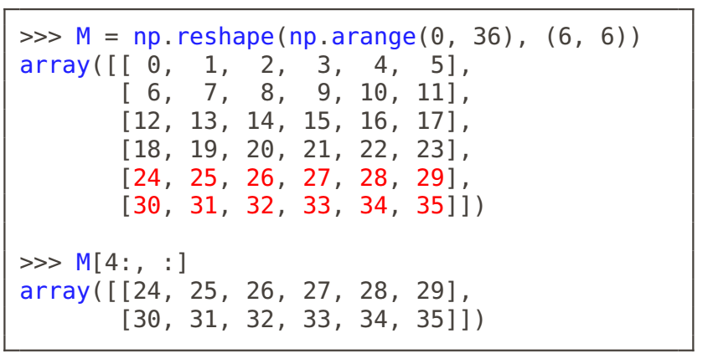
Indexing
To specify only column or row indices, use ":" alone.
Now we wish to extract two bottom rows.

Slide 18
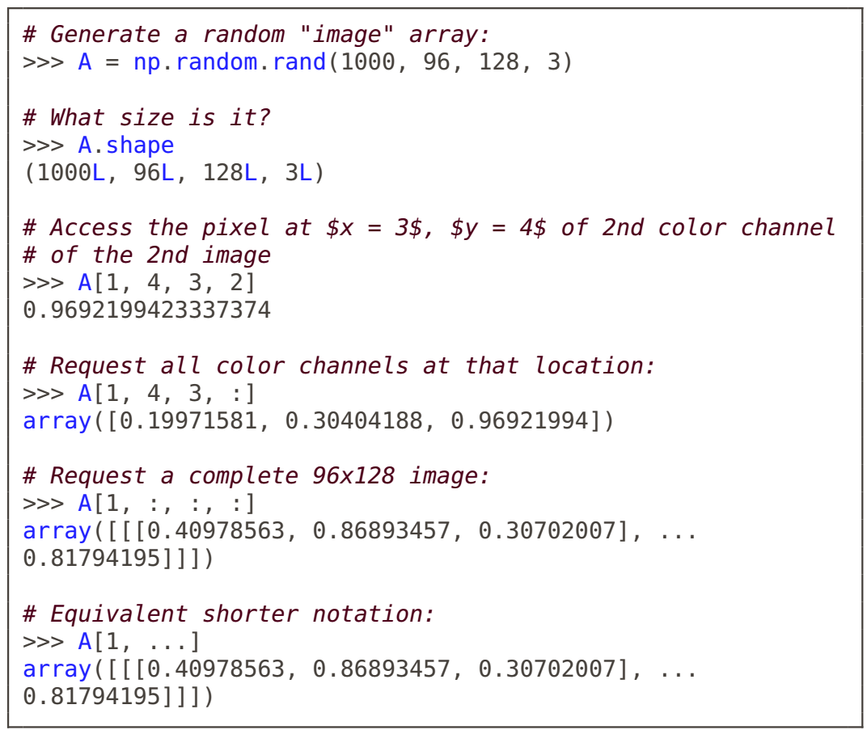
N-dimensional array
Higher-dimensional arrays are frequently encountered in machine learning.
For example, a set of 1000 color images of size w × h = 128 × 96 is represented as a 1000 × 96 × 128 × 3 array.
Here, dimensions are: image index, y-coordinate, x-coordinate, color channel.

Slide 19
Functions
Functions are defined using the def keyword.
Function definition can appear anywhere in the code.
Functions can be imported to other files using import.
Function arguments can be positional or named (see code).
Named arguments improve readability and are handy for setting the last argument in a long list.

Slide 20
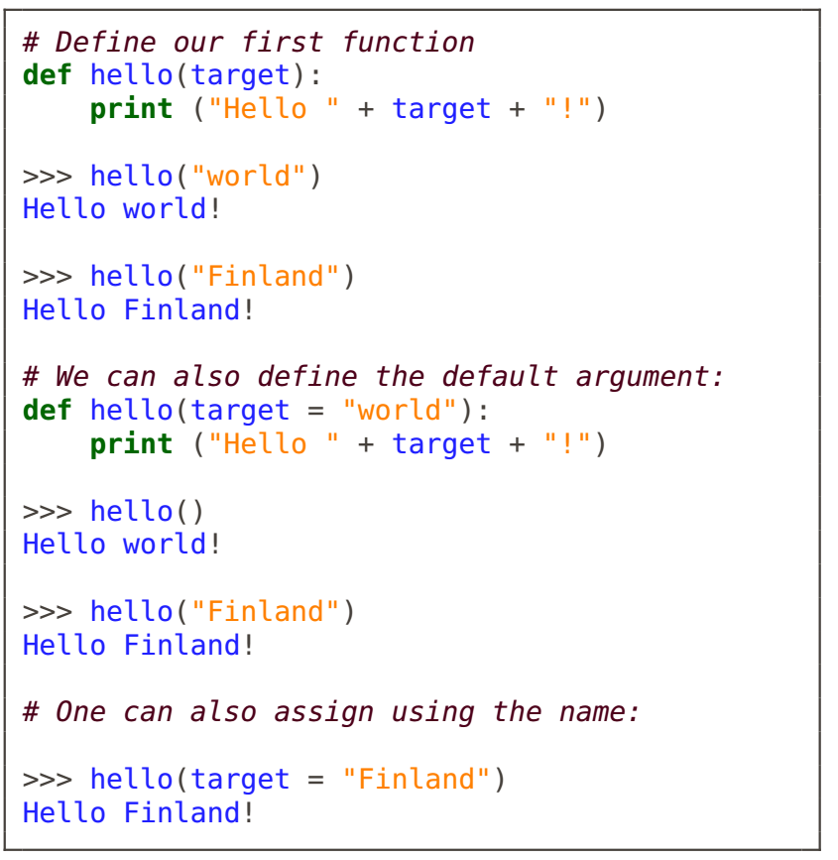
Functions

Slide 21
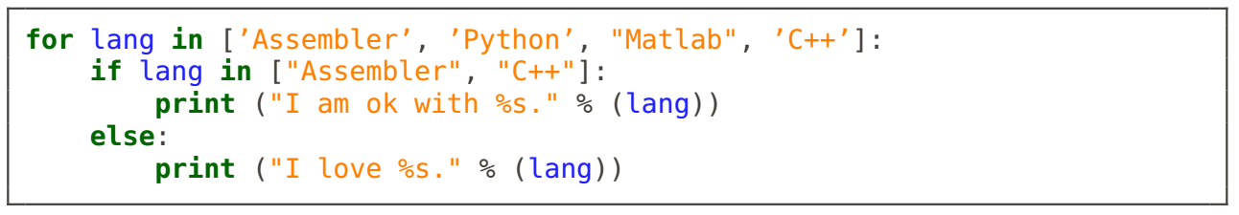
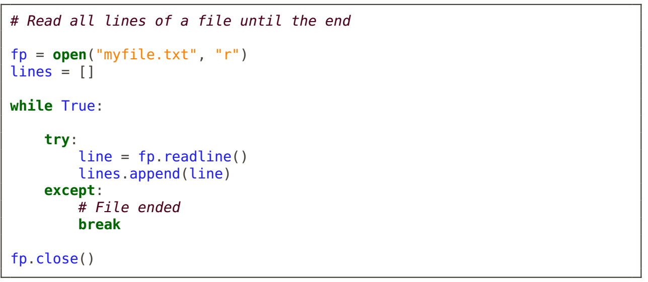
Loops and Stuff
Loops and other usual programming constructs are easy to remember.
for can loop over anything iterable, such as a list or a file.
In Matlab, appending values to a vector in a loop is not recommended. Python lists are actual lists, so appending is fine.

Slide 22
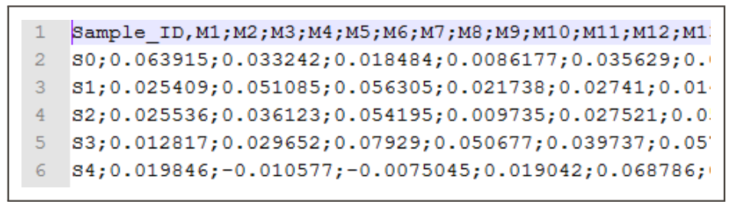
Reading in a Data file
Suppose we need to read a csv file (text file with Comma Separated Values) into Python.
The file consists of 216 rows (samples) with 4000 measurements each.
We will write file reading code from scratch.
Alternatively, many modules contain csv-reading functions
numpy.loadtxt
numpy.genfromtxt
csv.reader
pandas.read_csv

Slide 23
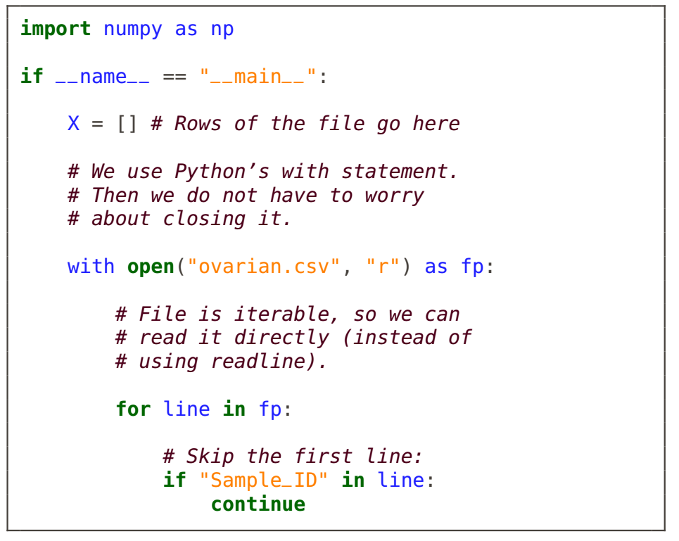
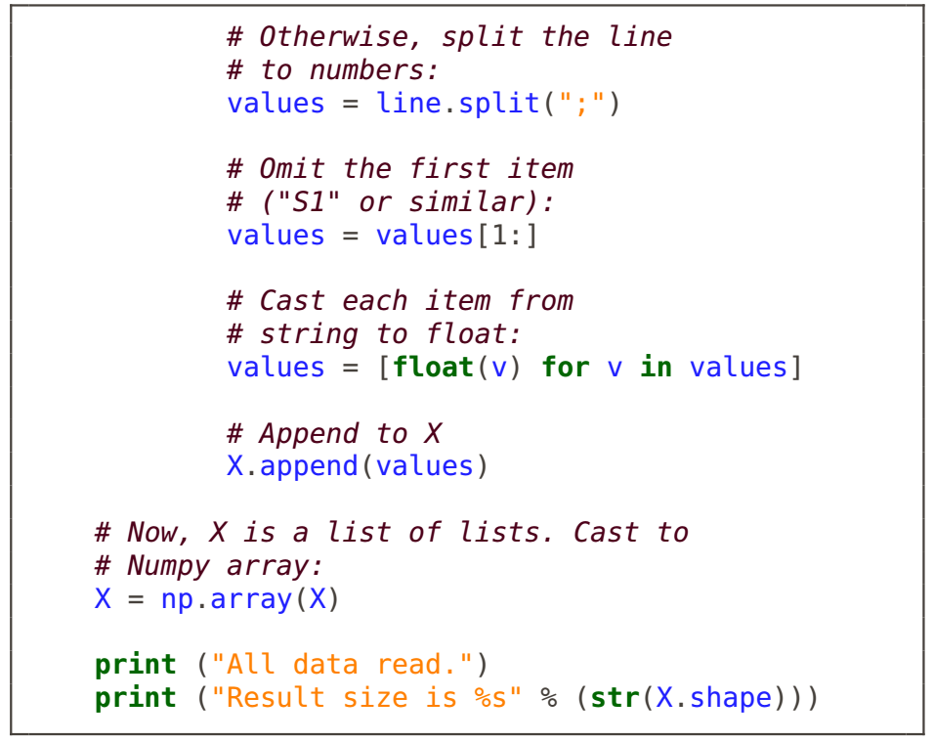
Reading in a Data file

Slide 24
Visualization
The matplotlib module is our plotting library.
Function names are often similar to Matlab.
Usually you want to "import matplotlib.pyplot".
Alternatively, "from matplotlib.pylab import *" makes the environment very similar to Matlab.

Slide 25
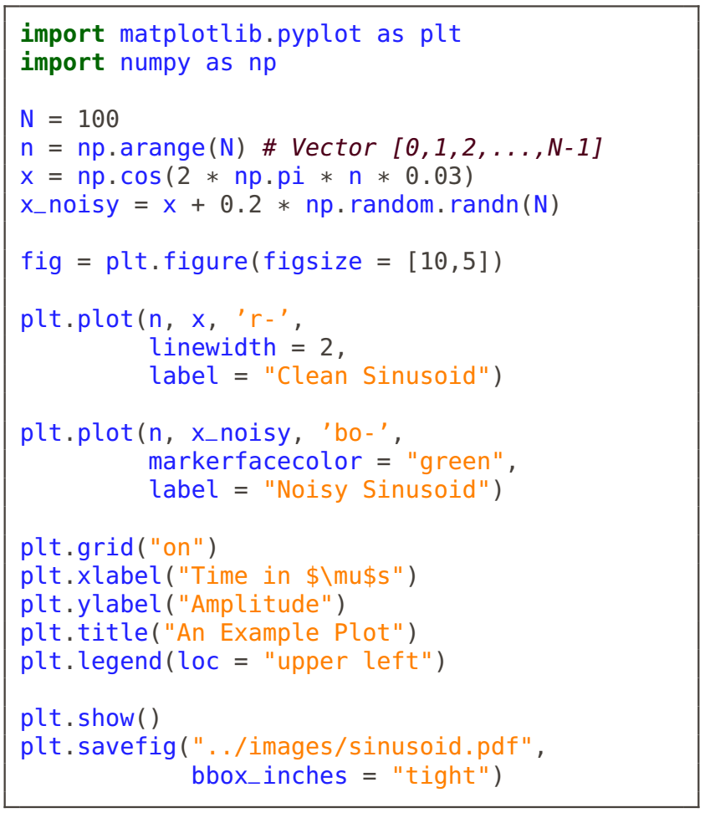
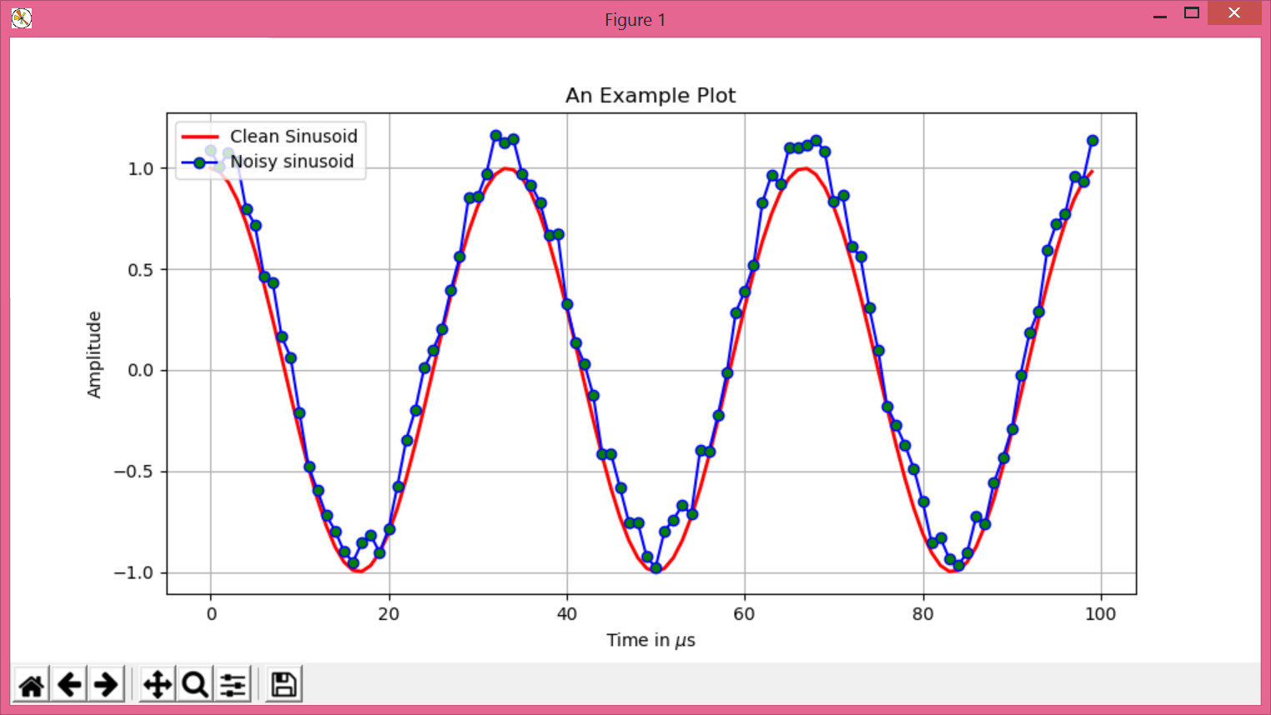
Visualization
Lec1_ex2.py

Slide 26
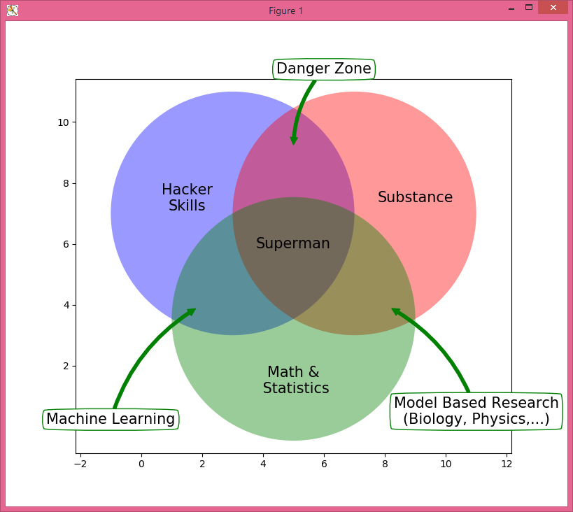
Visualization
Even rather complicated graphics are easy to generate using Matplotlib.
Lec1_ex3.py

Slide 27
TENSORFLOW!

Slide 28
What’s TensorFlow?
Open source software library for numerical computation using data flow graphs
Originally developed by Google Brain Team to conduct machine learning and deep neural networks research
General enough to be applicable in a wide variety of other domains as well
TensorFlow provides an extensive suite of functions and classes that allow users to build various models from scratch.

Slide 29
Why TensorFlow?
Python API
Portability: deploy computation to one or more CPUs or GPUs in a desktop, server, or mobile device with a single API
Flexibility: from Raspberry Pi, Android, Windows, iOS, Linux to server farms
Visualization (TensorBoard is da bomb)
Checkpoints (for managing experiments)
Large community (> 10,000 commits and > 3000 TF-related repos in 1 year)
Awesome projects already using TensorFlow

Slide 30
Get started
import tensorflow as tf
Simplified TensorFlow?
TF Learn (tf.contrib.learn): simplified interface that helps users transition from the the world of one-liner such as scikit-learn
TF Slim (tf.contrib.slim): lightweight library for defining, training and evaluating complex models in TensorFlow.
TensorFlow provides an extensive suite of functions and classes that allow users to define models from scratch.
High level API: Keras, TFLearn, Pretty Tensor

Slide 31
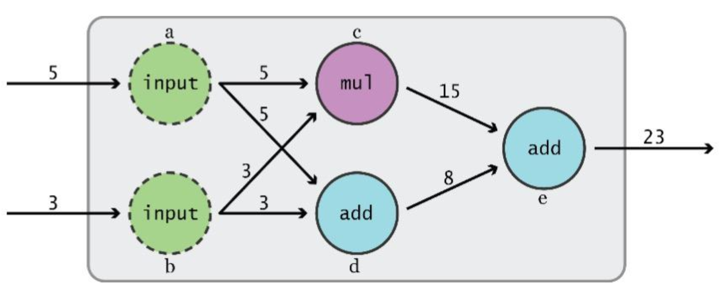
Data Flow Graphs
TensorFlow separates definition of computations from their execution
Phase 1: assemble a graph
Phase 2: use a session to execute operations in the graph.

Slide 32
What’s a tensor
An n-dimensional array
0-d tensor: scalar (number)
1-d tensor: vector
2-d tensor: matrix
and so on

Slide 33
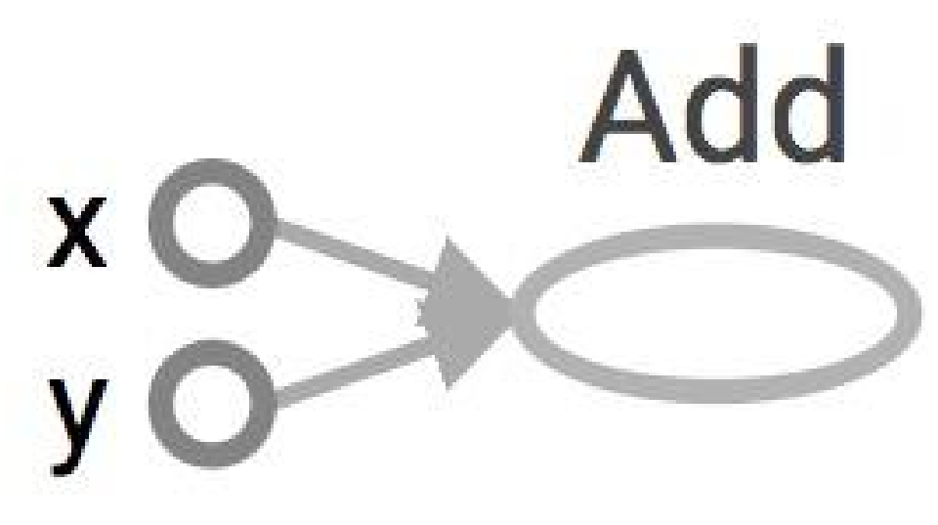
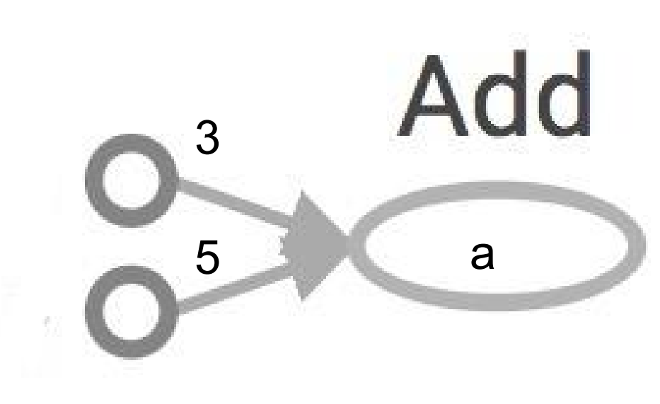
Data Flow Graphs
import tensorflow as tf a=tf.add(3,5)
TF automatically names the nodes when you don’t explicitly name them (x = 3, y = 5)
Nodes: operators, variables, and constants Edges: tensors
Tensors are data. Data Flow -> Tensor Flow

Slide 34
Data Flow Graphs
import tensorflow as tf a=tf.add(3,5)
print a
>> Tensor("Add:0", shape=(), dtype=int32) (Not 8)
How to get the value of a?

Slide 35
How to get the value of a?
Create a session, assign it to variable sess so we can call it later
Within the session, evaluate the graph to fetch the value of a
import tensorflow as tf a = tf.add(3, 5) sess = tf.Session() print sess.run(a) sess.close()
The session will look at the graph, trying to think: hmm, how can I get the value of a, then it computes all the nodes that leads to a.

Slide 36
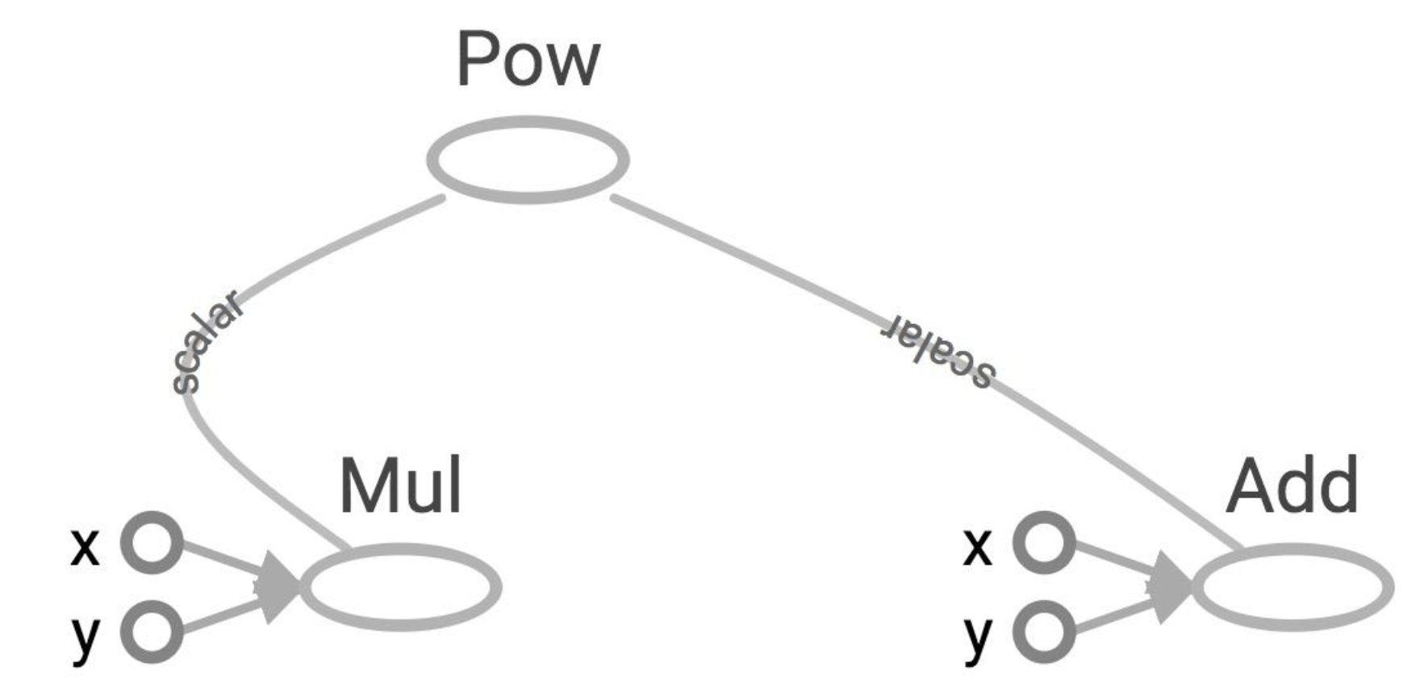
More graphs
x = 2 y = 3 op1 = tf.add(x, y) op2 = tf. multiply(x, y) op3 = tf.pow(op2, op1) with tf.Session() as sess: op3 = sess.run(op3)

Slide 37
Placeholders (inputs)
Placeholders are nodes whose value is fed in at execution time
(inputs, labels, …)
node1 = tf.placeholder(tf.float32) node2 = tf.placeholder(tf.float32) node3 = tf.add(node1,node2)
tf.Session().run(node3, {node1 : 3, node2 : 4})
You need to specify all placeholders on which the “subgraph you are using for your computation” depends

Slide 38
Variables (mutable state)
Variables are stateful nodes which output their current value. State is retained across multiple executions of a graph
(mostly parameters)
W = tf.Variable([.3], dtype=tf.float32) b = tf.Variable([-.3], dtype=tf.float32) x = tf.placeholder(tf.float32) linear_model = W * x + b #Operator Overloading! init = tf.global_variables_initializer() with tf.Session() as sess: sess.run(init)
sess.run(linear_model)

Slide 39
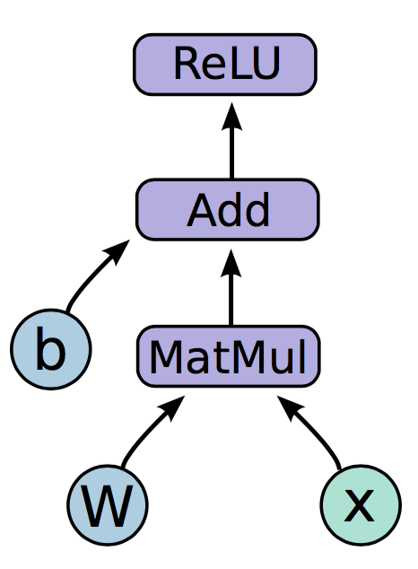
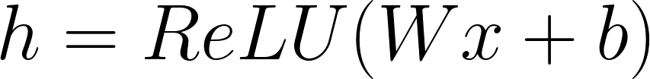
Neural network (Programming model)
h
W
b
x
a tensorflow graph
Notes:
We have two variables in this graph, the bias and W matrix.
The variables in your graph are going to be your parameters

Slide 40
Neural network (Programming model)
Mathematical operations:
MatMul: Multiply two matrices
Add: Add elementwise
ReLU: Activate with elementwise rectified linear function
0, x <= 0
ReLu(x) =
x, x > 0
Notes:
The other nodes are mathematical operations that you are familiar with. Matmul, addition, and relu are all operations in your graph that combine your inputs and parameters to produce new nodes.

Slide 41
Neural network (Programming model)
import tensorflow as tf b = tf.Variable(tf.zeros((100,))) W = tf.Variable(tf.random_uniform((784, 100), -1, 1)) x = tf.placeholder(tf.float32, (1, 784))
h = tf.nn.relu(tf.matmul(x, W) + b)

Slide 42
So far:
Built a graph using variables and placeholders
Deploy the graph onto a session, i.e., execution environment
Next: train model
Define loss function
Compute gradients

Slide 43
Defining loss
Use placeholder for labels
Build loss node using labels and prediction
prediction = tf.nn.softmax(...) #Output of neural network
label = tf.placeholder(tf.float32, [100, 10])
cross_entropy = -tf.reduce_sum(label * tf.log(prediction), axis=1)

Slide 44
Gradient computation: Backpropagation
train_step = tf.train.GradientDescentOptimizer(0.5).minimize(cross_entropy)
tf.train.GradientDescentOptimizer is an Optimizer object
tf.train.GradientDescentOptimizer(lr).minimize(cross_entropy) adds optimization operation to computation graph
TensorFlow graph nodes have attached gradient operations Gradient with respect to parameters computed with backpropagation … automatically

Slide 45
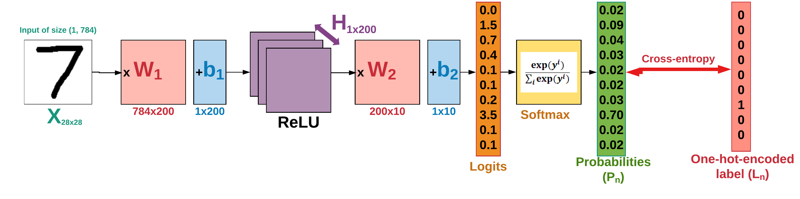
Classification of handwritten digits
Lec1_ex5.py
https://github.com/easy-tensorflow/easy-tensorflow/blob/master/3_Neural_Network/Tutorials/1_Neural_Network.ipynb

